Slide 1

SOLID Principles and DRY
SOLID, DRY, YAGNI, KISS
Telerik Software Academy
Learning & Development
http://academy.telerik.com

Slide 2

Table of Contents
SOLID Principles
SRP – Single Responsibility Principle
OCP – Open/closed Principle
LSP – Liskov Substitution Principle
ISP – Interface Segregation Principle
DIP – Dependency Inversion Principle
DRY – Don't Repeat Yourself
YAGNI – You Aren't Gonna Need It
KISS – Keep It Simple, Stupid

Slide 3

Bla bla

Slide 4
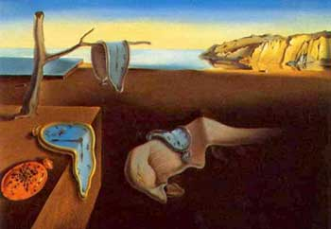
Bla bla
Bla bla

Slide 5
Inversion of Control (IoC)
Inversion of Control (IoC) is an abstract principle in software design in which
The flow of control of a system is inverted compared to procedural programming
The main control of the program is inverted, moved away from you to the framework
Basic IoC principle:
Implementations typically rely on callbacks
Don't call us, we'll call you!

Slide 6
SOLID Principles and DRY
http://academy.telerik.com

Slide 7




Free Trainings @ Telerik Academy
C# Programming @ Telerik Academy
csharpfundamentals.telerik.com
Telerik Software Academy
academy.telerik.com
Telerik Academy @ Facebook
facebook.com/TelerikAcademy
Telerik Software Academy Forums
forums.academy.telerik.com

